Slide 1
Deep learning on ML Engine
Balázs Tóth
Software Engineer at Trustpilot

Slide 2
About me
Software engineer at Trustpilot
Applied machine learning to detect fake reviews and fraudulent user behavior

Slide 3
Agenda
Overview of an ML engine service in the fraud detection context
A tutorial on training neural networks with Keras on ML Engine

Slide 4
The problem
Limitations of your local computer
Limitations of your time

Slide 5
Why do we use ML Engine in Trust and Transparency?

Slide 6
Why do we use ML Engine in Trust and Transparency?
Train multiple models in parallel
Easy access to powerful computers
Easy to deploy and maintain models
Hyperparameter optimization
Good ecosystem with Dataflow and BigQuery

Slide 7
Why do we use ML Engine in Trust and Transparency?
Train multiple models in parallel
Easy access to powerful computers
Easy to deploy and maintain models
Hyperparameter optimization
Good ecosystem with Dataflow and BigQuery

Slide 8
Why do we use ML Engine in Trust and Transparency?
Train multiple models in parallel
Easy access to powerful computers
Easy to deploy and maintain models
Hyperparameter optimization
Good ecosystem with Dataflow and BigQuery

Slide 9
Why do we use ML Engine in Trust and Transparency?
Train multiple models in parallel
Easy access to powerful computers
Easy to deploy and maintain models
Hyperparameter optimization
Good ecosystem with Dataflow and BigQuery

Slide 10
Why do we use ML Engine in Trust and Transparency?
Train multiple models in parallel
Easy access to powerful computers
Easy to deploy and maintain models
Hyperparameter optimization
Good ecosystem with Dataflow and BigQuery

Slide 11
Overview of an ML Engine Service

Slide 12

Spammer adversaries in Trustpilot

Slide 13
Solution: Spam review detector

Slide 14
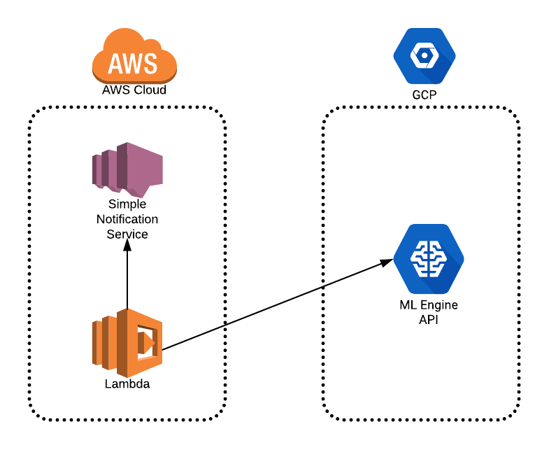

Slide 15
Evolution of spam reviews
with the iterations of the spam review detector

Slide 16
Machine learning workflow
Preprocessing - Google Dataflow
Training and evaluation - Google ML Engine
Deployment of the model - Google ML Engine API
Batch prediction (2nd part of evaluation) - Google ML Engine

Slide 17
Machine learning workflow
Preprocessing - Google Dataflow
Training and evaluation - Google ML Engine
Deployment of the model - Google ML Engine API
Batch prediction (2nd part of evaluation) - Google ML Engine

Slide 18
Machine learning workflow
Preprocessing - Google Dataflow
Training and evaluation - Google ML Engine
Deployment of the model - Google ML Engine API
Batch prediction (2nd part of evaluation) - Google ML Engine

Slide 19
Machine learning workflow
Preprocessing - Google Dataflow
Training and evaluation - Google ML Engine
Deployment of the model - Google ML Engine API
Batch prediction (2nd part of evaluation) - Google ML Engine

Slide 20
A tutorial on training neural networks with Keras on ML Engine

Slide 21
Example application: Classification of newsgroups
Public Dataset:
http://qwone.com/~jason/20Newsgroups/
Code:
https://github.com/tothbalazs0920/ml-engine-example

Slide 22
Use only 4 groups
atheism
religion
graphics
science

Slide 23
Setup a project on Google Cloud Console
Enable ML Angine API’s
Install Google cloud command line tools

Slide 24
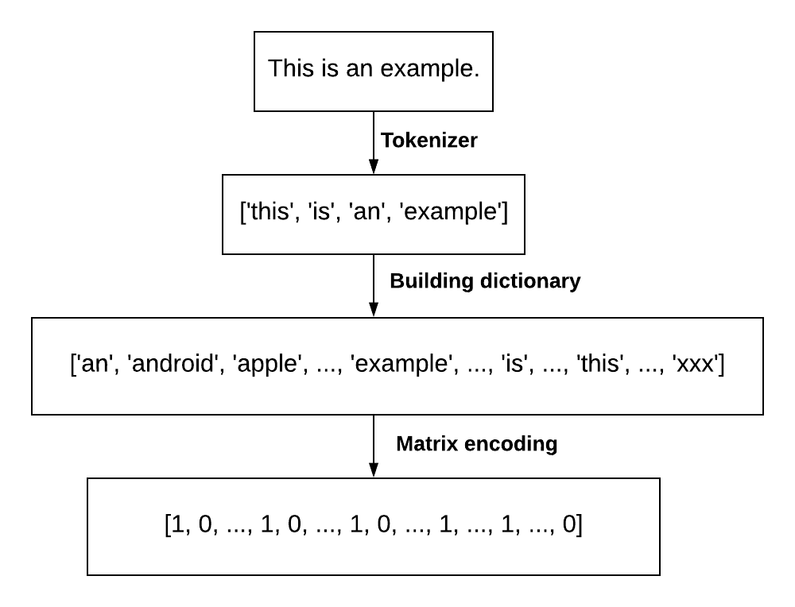
2. Preprocess the data - bag of words

Slide 25
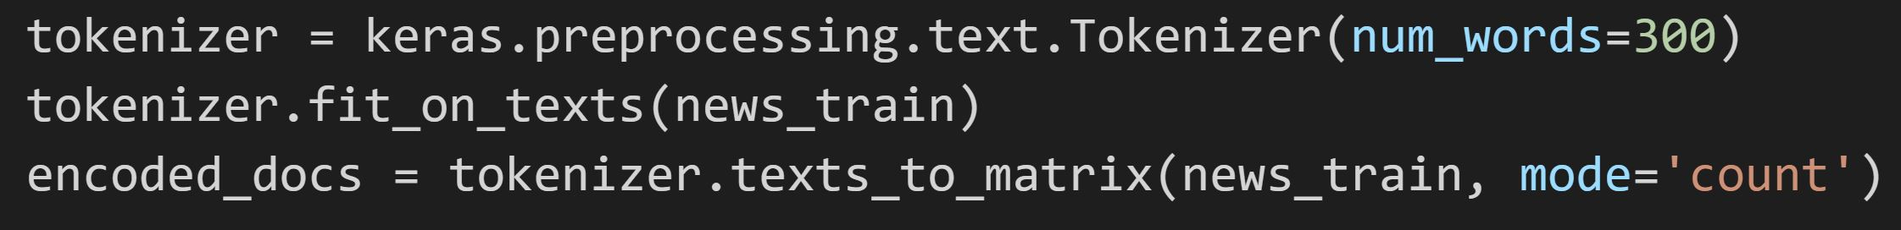
2. Preprocess the data and upload the preprocessed data to a gcs

Slide 26
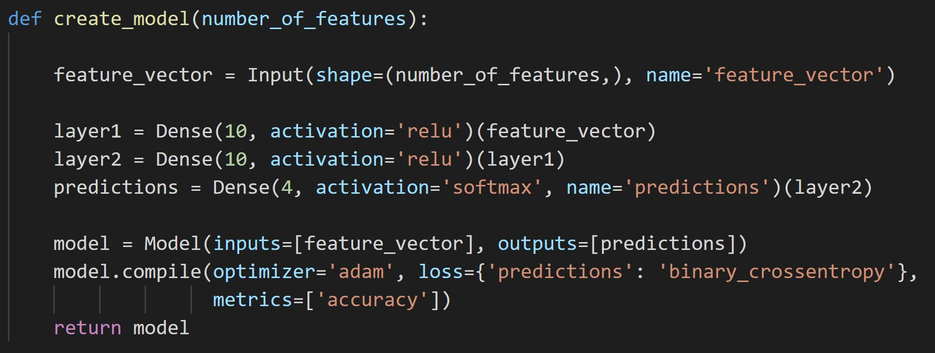
3. Create a Keras model

Slide 27
3. Create a Keras model

Slide 28
4. Set up the training in Keras
model.fit() and use a machine with a lot of memory (256 GB)
model.fit_generator() and use a machine with less memory

Slide 29
4. Set up the training in Keras
model.fit() and use a machine with a lot of memory (256 GB)
model.fit_generator() and use a machine with less memory

Slide 30
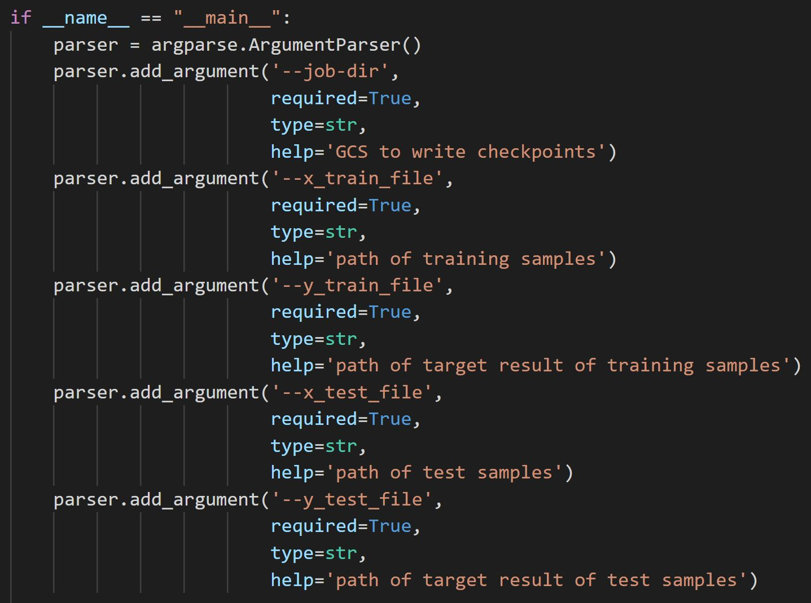
5. Add arguments to the entry file

Slide 31
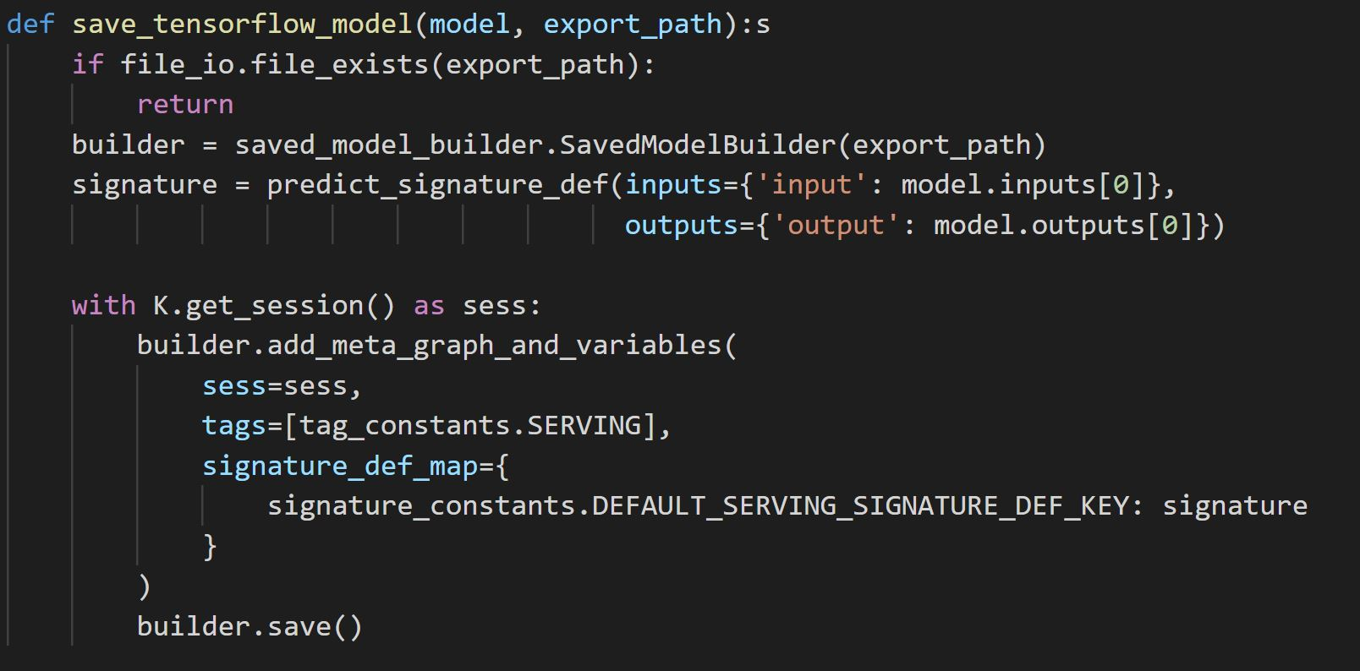
6. Convert the keras model to tensorflow model after training

Slide 32
7. Create a python package and upload it to a gcs
python setup.py sdist --formats=gztar

Slide 33
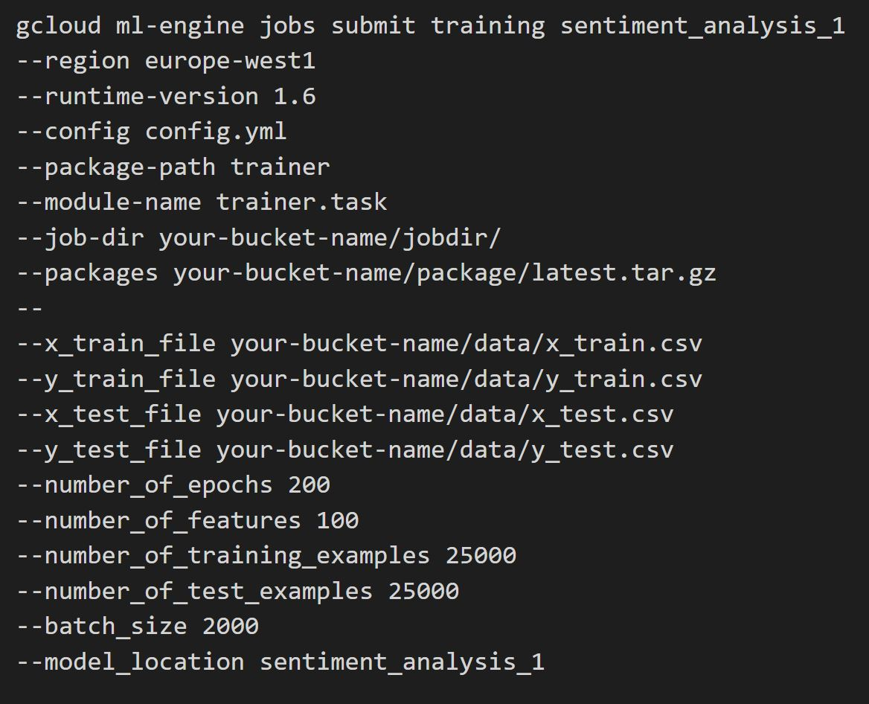
8. Submit a training job to ML Engine

Slide 34
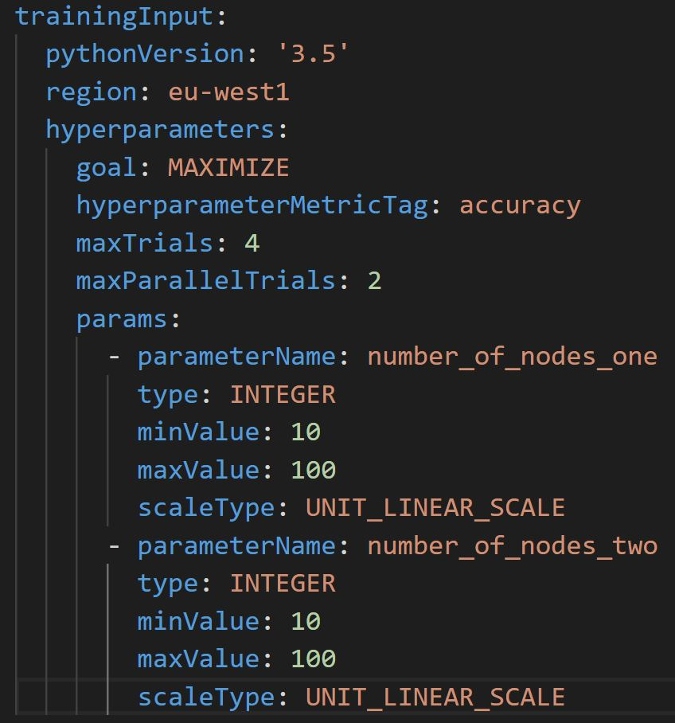
Hyperparameter tuning

Slide 35
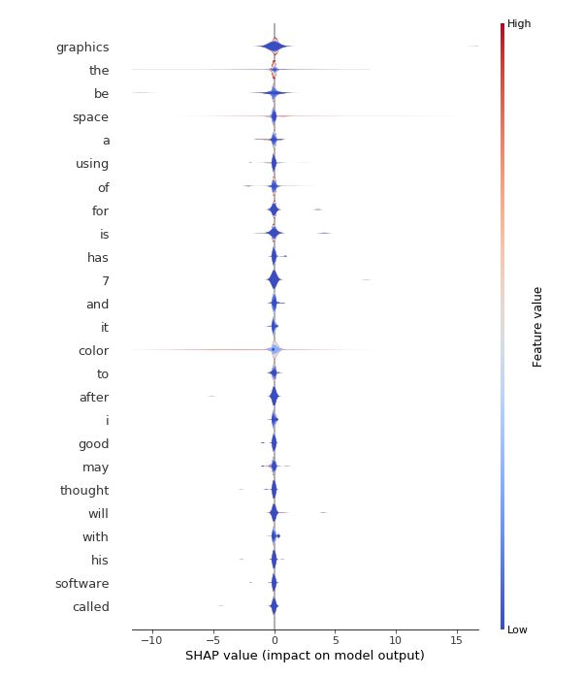
Interpreting the model with SHAP

Slide 36
Thank you
Email: bat@trustpilot.com
LinkedIn: https://www.linkedin.com/in/balazs-toth-6186005a/

